Slide 1
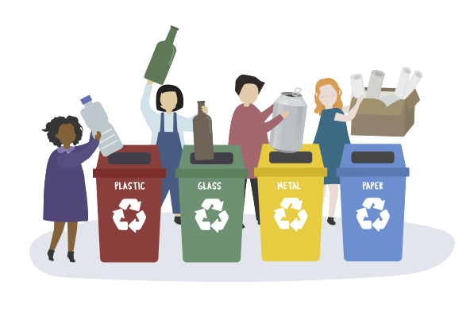

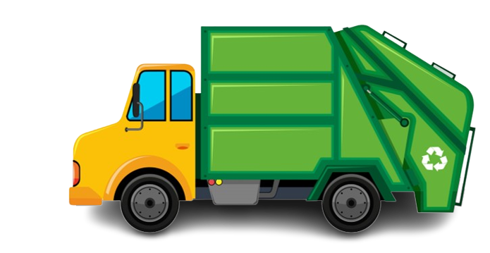
Group - 10
VIDA
MAKING AN ACTIVE EFFORT

Slide 2
Project Outline
Waste management is a major issue because of the volume of waste produced daily in the world. Waste classification is a big aspect of this issue. But what if we could automate the process using AI?
To manage a spectrum of waste products, it's crucial to have an advanced/intelligent waste management system.
The process of separating the waste into its many components is one of the most crucial parts of waste management, and it is typically carried out manually by hand-picking.
To simplify the process, we propose an intelligent waste material classification system.

Slide 3
Index
Data Collection
Data
Pre- Processing
Optimal Case
Team members
What are we trying to build
Abstract
Concepts Used
Algorithm Used
Comparison of models
Diagram(s) or Visualization(s)
Final Recommendation
Business use cases
Challenges Faced
Our Learning
Future Enhancements
Demo

Slide 4
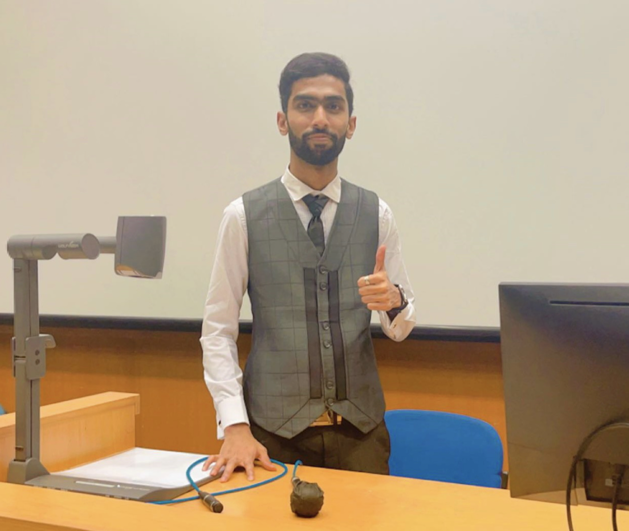
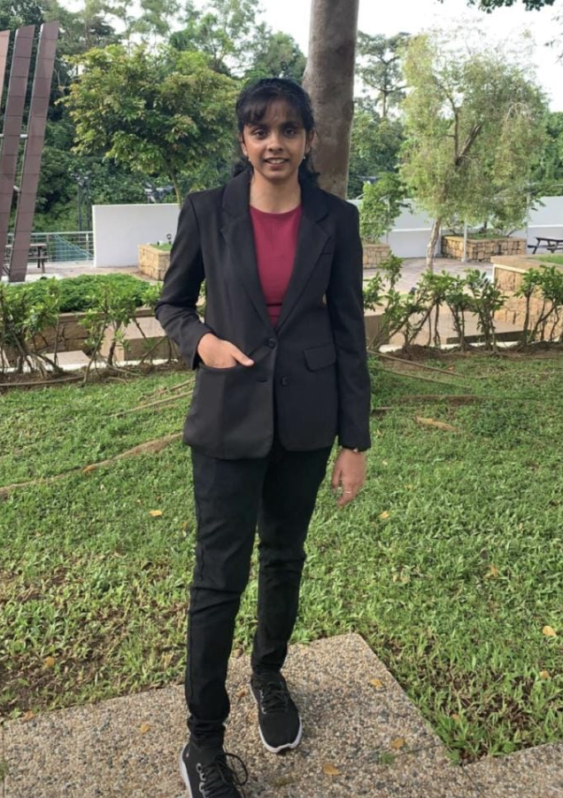


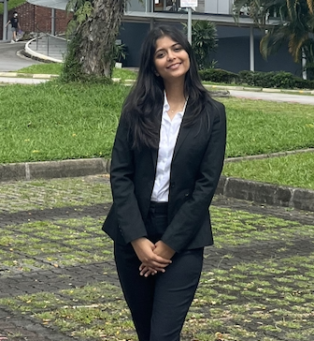
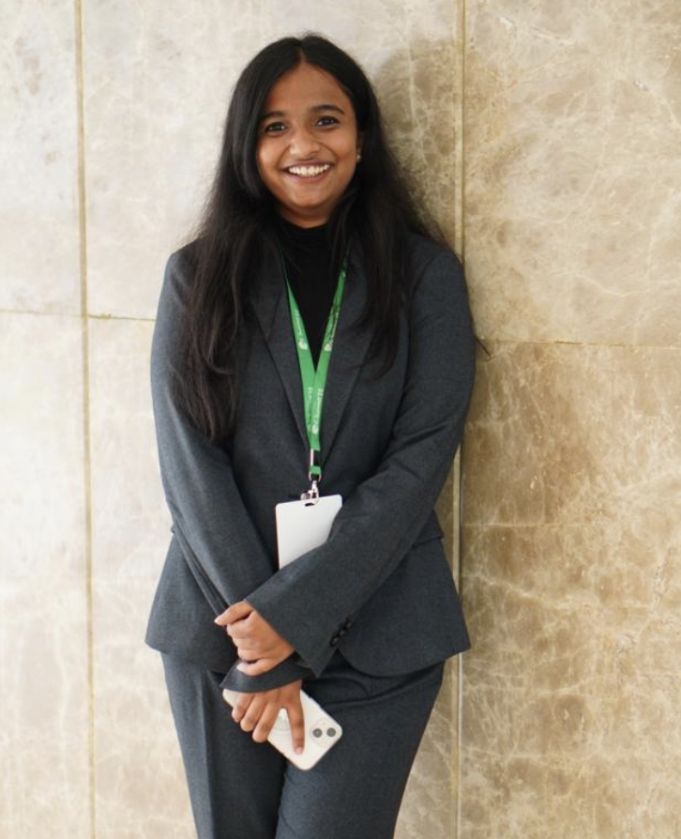
We the Team!
TEAM LEAD : JOHN HARSHITH
MODEL BUILDING & DEPLOYMENT
J SAKETH KUMAR
DATA PROCESSING & HYPERPARAMETER TUNING
ANITA PRIYADARSHINI A
FRONTEND DEVELOPMENT & DEPLOYMENT
ISAAC RITHARSON P
MODEL BUILDING & EVALUATION (USING ORANGE)
ADITI DUDHORIA
BUSINESS PLANNING & PRESENTATION
PRIYA TIWARI
DATA ANALYSIS & HYPERPARAMETER TUNING

Slide 5




What we are trying to build?
We are attempting to build a web application that can help users easily segregate waste into one of 6 classes:- Cardboard, Glass, Metal, Paper, plastic, and trash.
We have used deep learning models to classify our uploaded image.
Besides this, we have implemented a web interface to accompany the same.

Slide 6

Abstract
The classification of trash is essential for resource recycling and environmental protection. Different categories of garbage are now defined by laws passed in various nations on garbage classification.
However, it was discovered during the implementation of these laws that were accurately differentiating between various sorts of waste still needs to be solved.
In this project, the work of garbage classification will be finished using a deep learning model. In particular, the classification performance of VGG16 and CNN based on a publicly accessible image data set is compared.
We discovered that the overall method's prediction results are more precise than those of a single neural network model and among the many ensemble strategies.
The model with the highest accuracy is chosen and deployed with the Web interface.

Slide 7
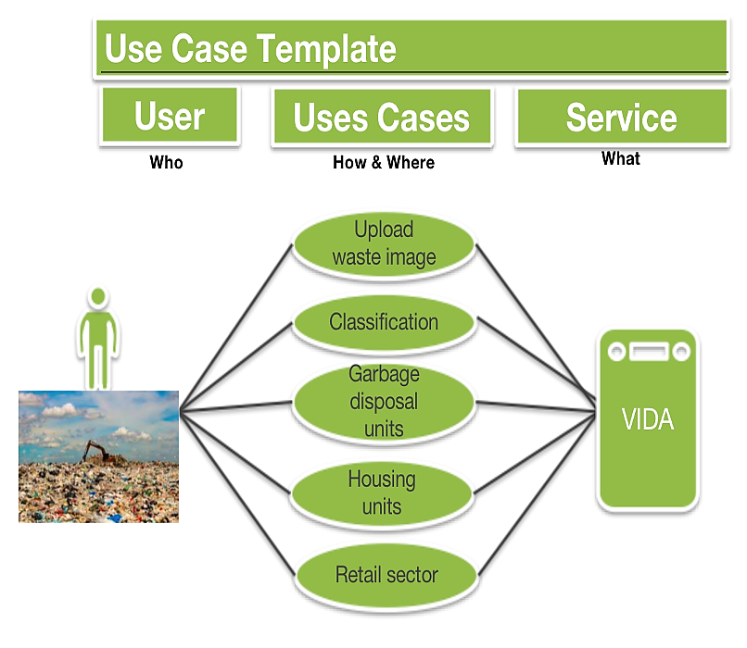
Business Use Case

Slide 8
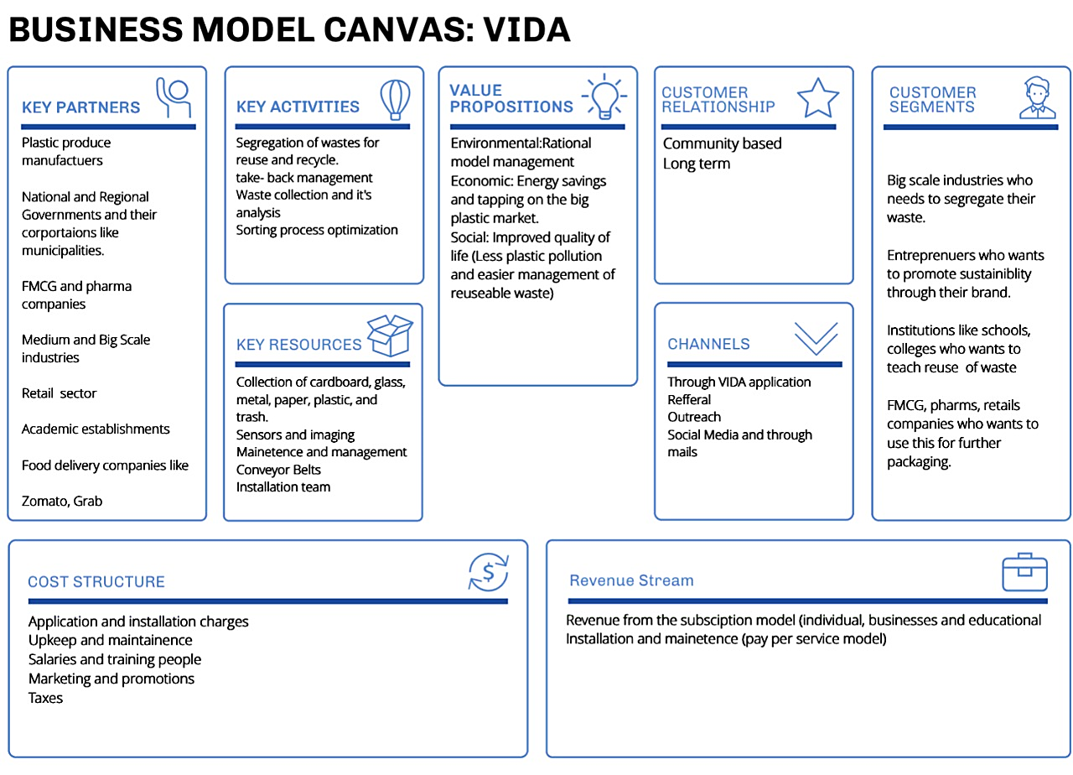

Slide 9
Important Use Case
Most standard business models that revolve around the utilizing waste as a resource are:
- companies that collect and transport the waste
- companies that treat waste after separating it
- companies that produce energy from waste
- companies that sell the waste after processing it into other products
Our focus is on the second case model, i.e., the separation of wastes.
The population has increased, and with it, waste generation has grown. Manual segregation leads to a waste of time and money. So our most important use case solves this problem for our target audience by using a deep learning model to do this work for you efficiently. We can further improvise this process by automatically capturing the photos as the waste moves through a conveyor belt or any similar mechanism. This can significantly reduce human intervention in trash segregation and improve the accuracy of the same.

Slide 10
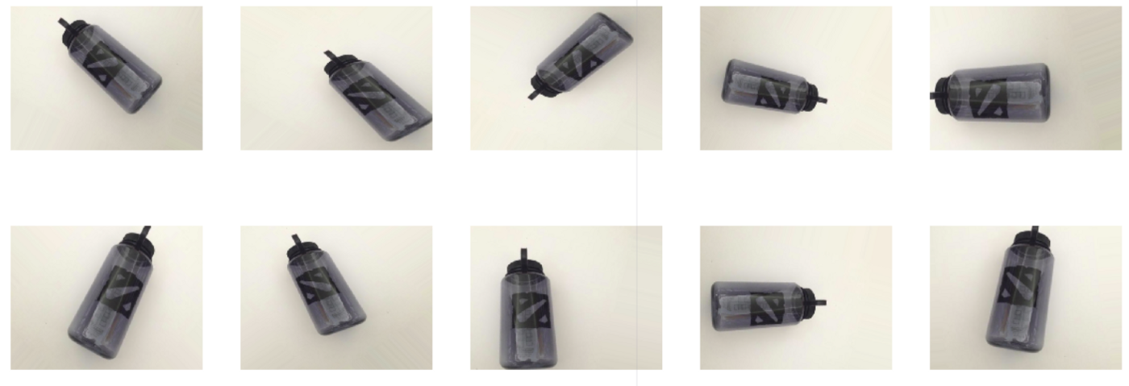



Concepts Used
Image Classification
Data Scraping (Collection)
Data Cleaning
Data Augmentation
Data Preprocessing (Resizing)
Train-Test Split for Training and Testing
Model selection
Model Building/Training (Tensorflow/Keras)
Testing and Evaluation
Model Optimization and Hyper Parameter Tuning
Final Results
Interpreting Visualizations (Orange Data Mining)
+

Slide 11
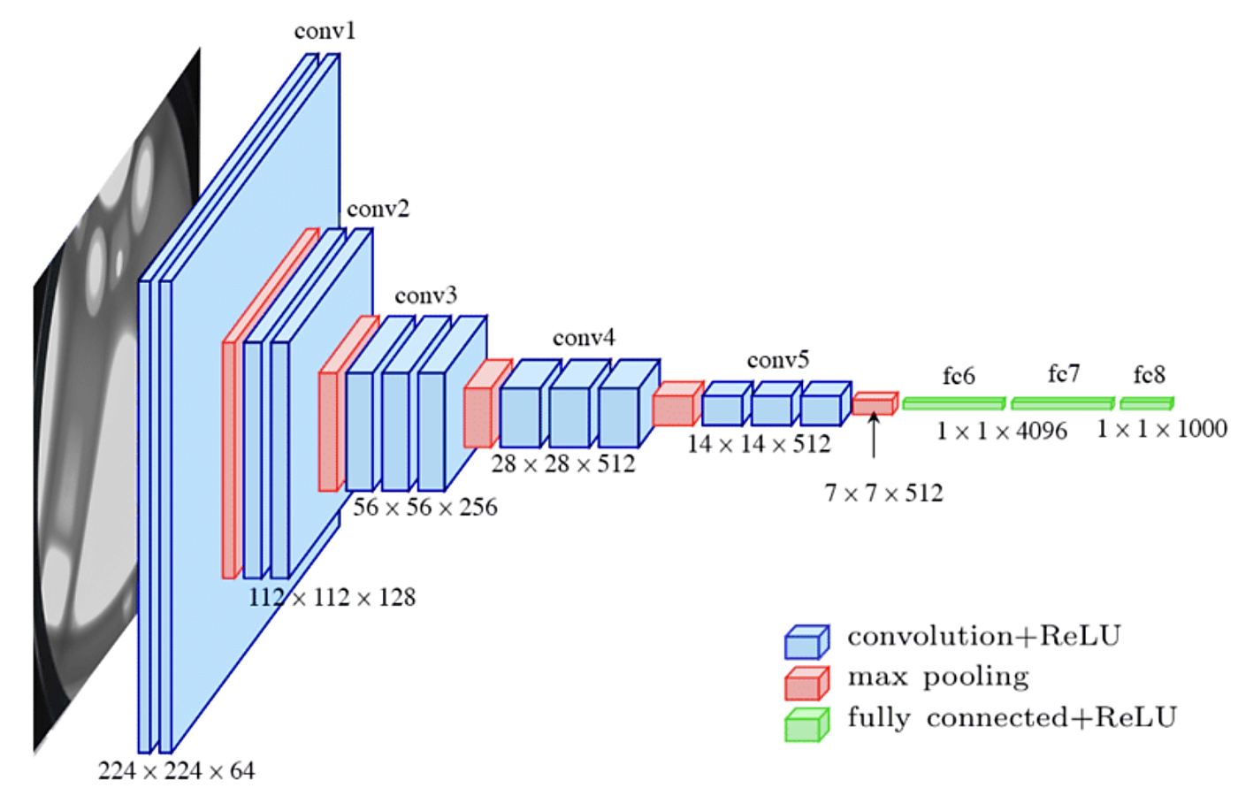
Algorithm Used
For our model the algorithms we’ve used are:
CNN (Convolutional Neural Network)
VGG-16(Visual Geometry Group-16
)

Slide 12
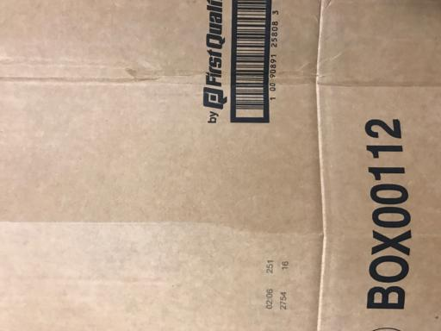
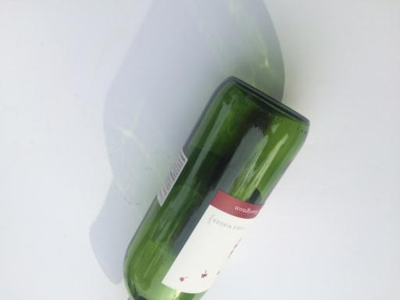
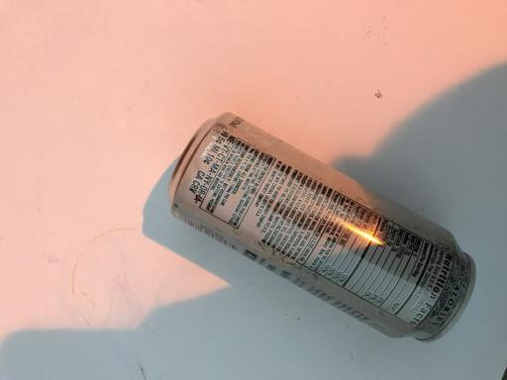
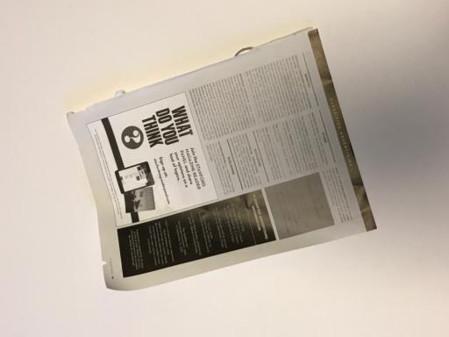
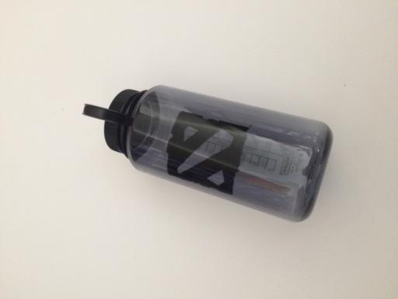
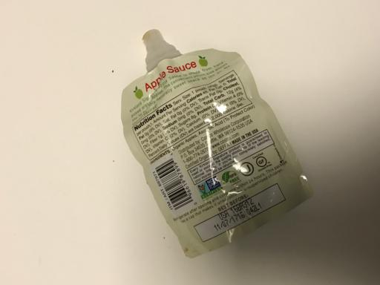
Our Data
About Dataset
The data was obtained through the Kaggle website and The Garbage Classification Dataset contains 6 classifications: cardboard (393), glass (491), metal (400), paper(584), plastic (472) and trash(127).
1.cardboard 2.glass 3.metal 4.paper
5.plastic
6.trash

Slide 13
Data Collection
Since we require an image dataset, we had to scrape images from the internet.
For web-scraping we used an API.
Besides scraping images from the internet, we even took garbage images from Kaggle.
We were able to scrap 813 images from the internet and able to get 1982 images from Kaggle.
The whole dataset was then divided into six categories, namely : Cardboard, glass, plastic, metal, paper and other garbage.

Slide 14
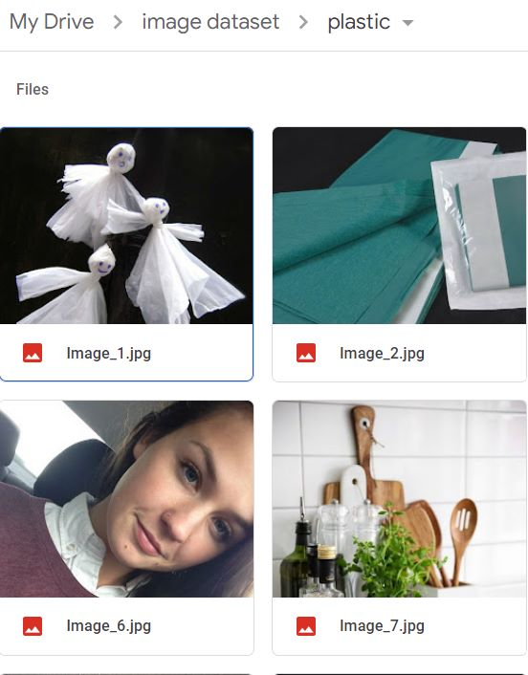

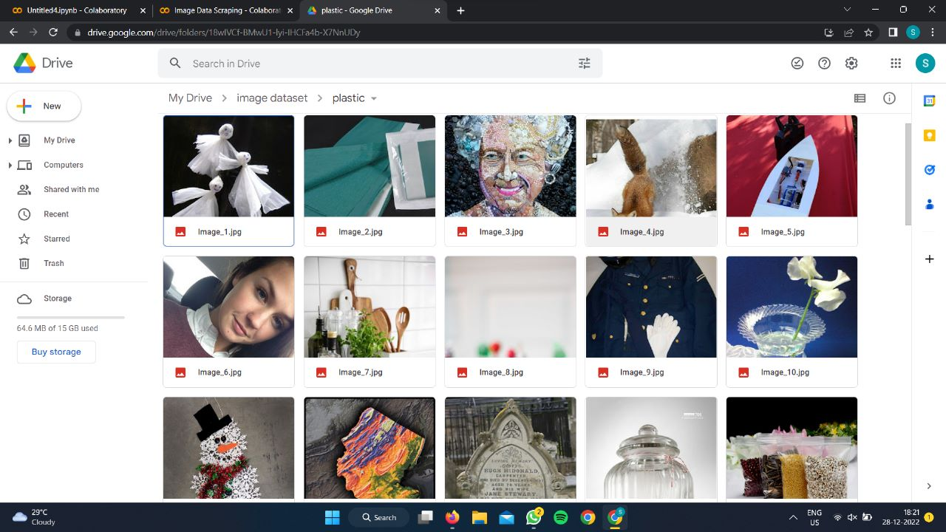
Data Pre-processing
Though we had the dataset, the images from Kaggle were relatively much more cleaner than compared to the web-scrapped ones, so the images from web had to be manually cleaned, since many contained irrelevant images.
Finally after clearing 268 images from our dataset, we were left with 2527 relevant images.
As far as the processing of the images goes, after cleaning our dataset, we then had to resize all the images of the dataset, so as to get an uniform sized images in our dataset.
Then we augmented our data to reduce overfitting by forming new and different examples to train datasets.

Slide 15
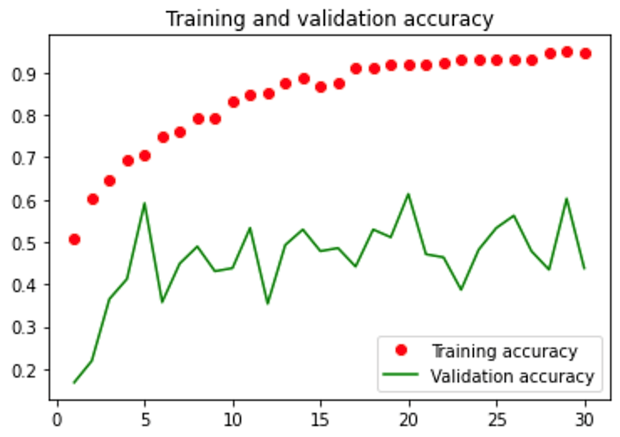
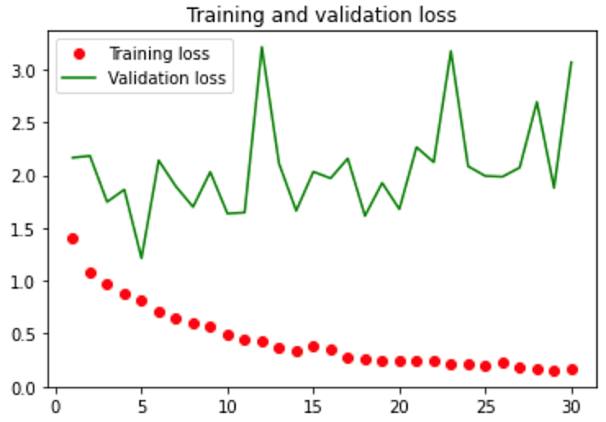
Diagram(s) or Visualization(s)

Slide 16
Optimal Case
Training Accuracy ~ 97%
Test Accuracy ~ 95%
Hyperparameter :
Number of epochs = 100
Loss function = Categorical cross entropy
Optimizer function = Adam
Train: Test split = 0.2
Using the above parameter values, will give us the optimal model (VGG16 in this case here)

Slide 17
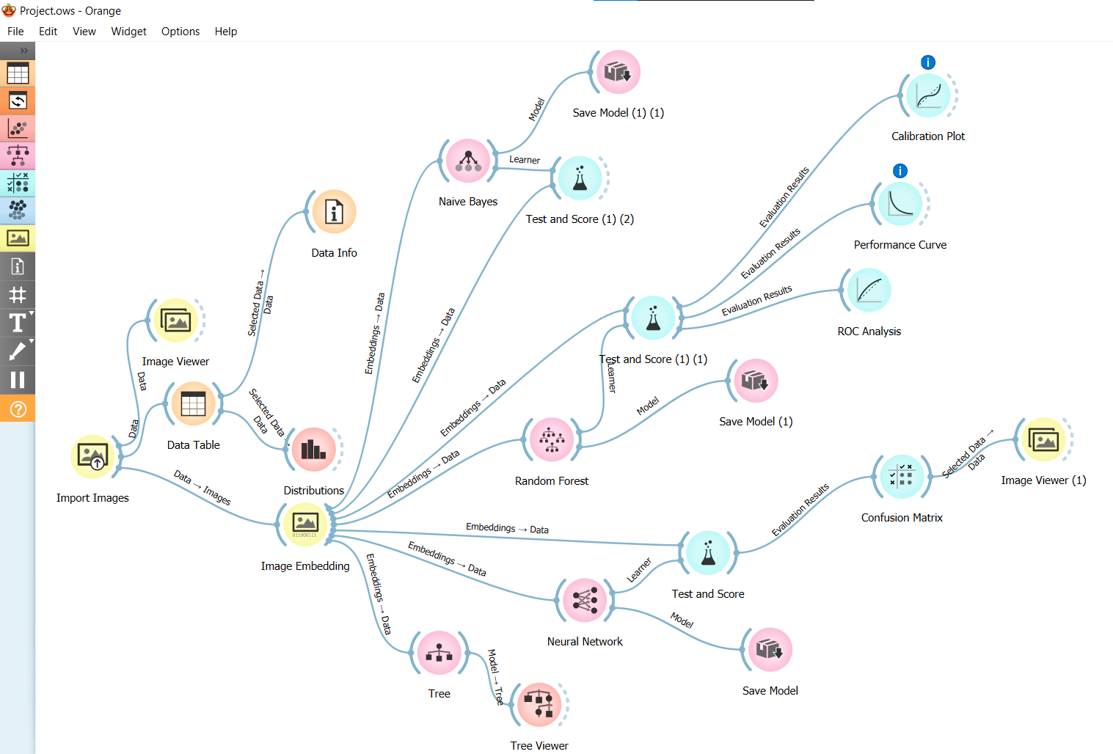
Validation using Orange Software
Model Pipeline:

Slide 18
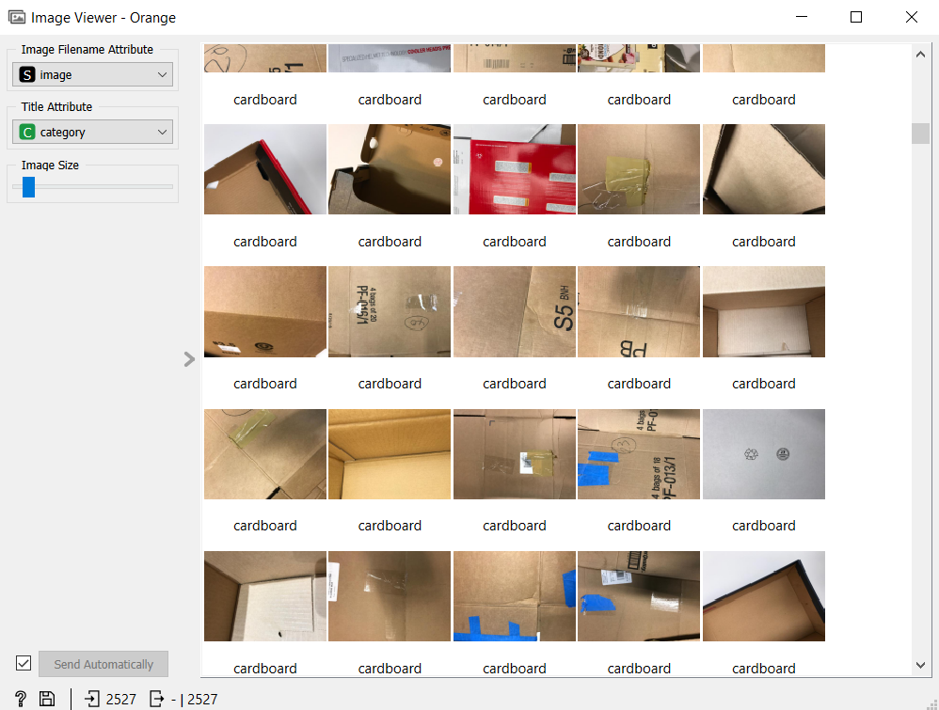
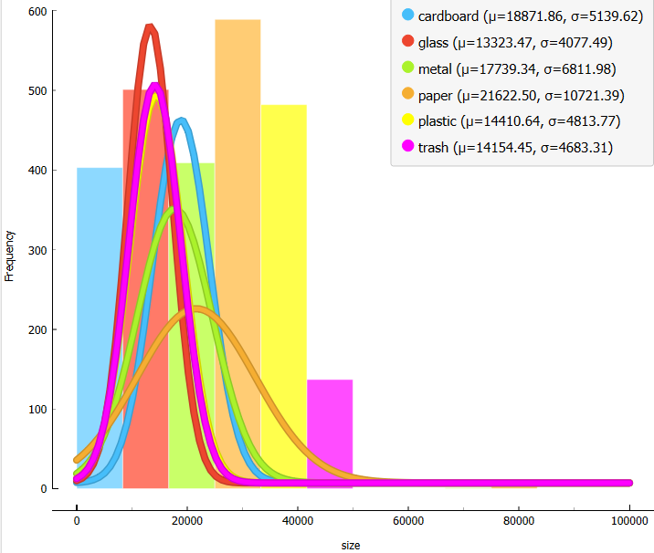
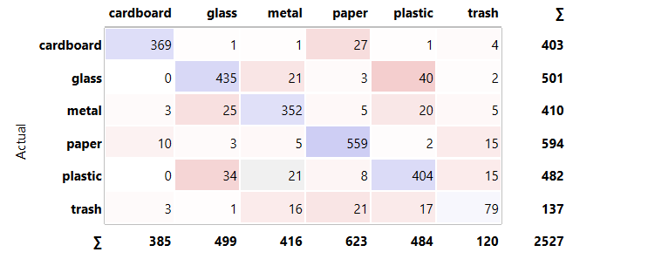
Std. Dev
mean
Size Distribution of Images
Image Viewer
MPL Model with 100 hidden neurons, Activation= ReLu, Optimizer = Adam , Alpha( Learning Rate =0.0001), Max_iterations = 200

Slide 19
Actual- glass
Actual- Cardboard
Actual- plastic
Predicted-plastic (40 images)
Predicted-Paper (27 images)
Predicted-glass (34 images)
Actual- Glass
Predicted-Metal (21 images)
Actual –Plastic
Predicted- Metal (21 images)
Actual- glass
Predicted-plastic (40 images)

Slide 20
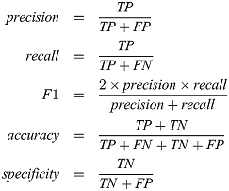
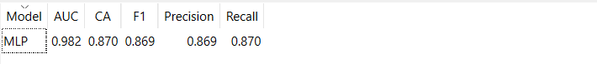
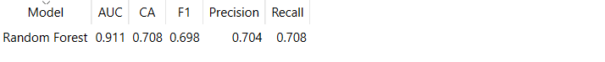
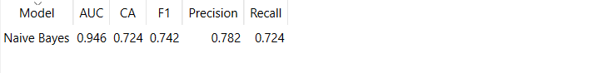
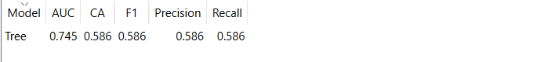
Comparative Analysis
To be able to prove that Deep Learning Models Performed Better than Machine Learning on our Dataset

Slide 21
Final Recommendation
Using transfer-learning models like ResNet, MobileNet etc could have led to slightly better accuracy than the ones we used. This is because by using pre-trained model as a starting point, it is possible to leverage the knowledge learned by the model and improve the performance of the new model on the task at hand. VGG-16 gave the highest accuracy otherwise. ​​
The model needs to be trained more on a larger dataset to get better results with an accuracy that can be deployed in the industrial level.
The number of classes needs to be increased to include various types as subclass in the classes itself. For eg: plastic could be further be polythene, pvc etc.

Slide 22
Challenges Faced
During the initial stages of the project, all members of the team had to learn and understand the techniques used in implementation of deep learning in real world applications and the approaches taken to successfully build a business concept/model from the problem statement
We had to thoroughly understand the data science life cycle and how it worked from data acquisition to deployment of models in order bring an actionable useful outcome
During the Data preprocessing step, we faced difficulty in exploring the dataset containing several images of the garbage waste. Later while building the model we had to choose the models which were quite efficient in performance in terms or accuracy, training and time period.
Finally building an interactive user website and deploying it on Azure was quite challenging since we were all new to the cloud interface.

Slide 23
Our Learning
Through this project, we understood the importance of an outcome-based approach in a data science life cycle and the impact of Deep Learning techniques to improve the efficiency and performance of humankind in day-to-day activities.
We also learned the in-depth concepts of convolutional neural networks and their implementation in python, along with several models like VGG-16, etc. We implemented concepts of Flask and Azure.
It was interesting to see a solution to a real-world problem and how it could potentially create a massive market in the industry and contribute to the social community and its welfare.
There were few instances where we had to scrap our models and start the work again due to constraints about models which were not allowed to use. We tried our best to fight these circumstances together as a team.
It was also great fun to work as a team and understand several perspectives of the different members on the same concept, which helped everyone share their knowledge and help each other out in difficult situations (i.e., becoming team players).

Slide 24
Future Enhancements
More models will be put to the test for the same purpose, and we'll determine which model performs best before implementing it.
To further ensure substantially larger accuracy, we are intending to drastically expand the size of the dataset.
Improve the interface of the webpage and our model, so that this model of ours is easy-to-use by the end-user.
Actually deploying the model, so that it will be accessible to anyone with internet.
Using transfer learning models to get a slightly better accuracy and performance.

Slide 25
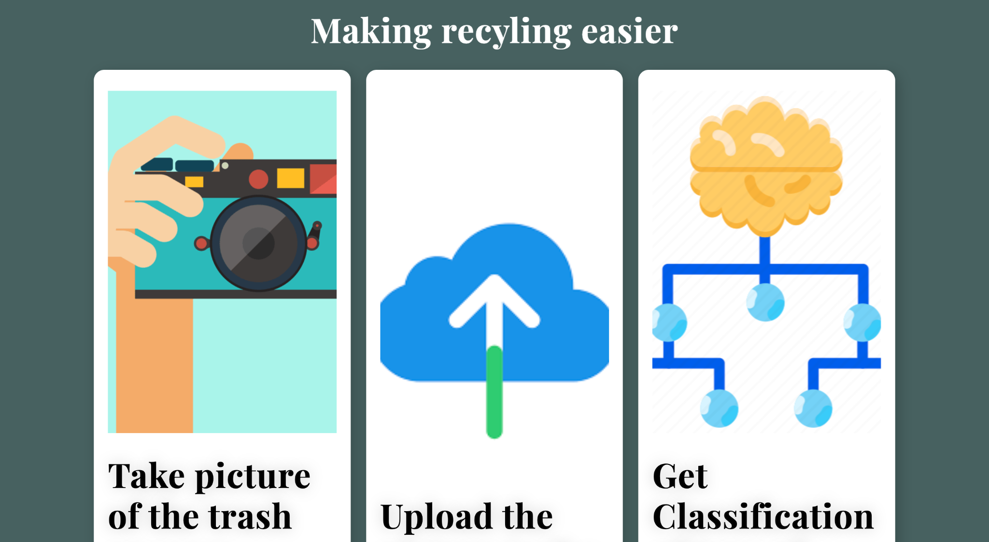
Demo

Slide 26
TEAM NO: 10
Thank You

